Slide 1
Machine Learning I Regression analysis of Student grade data
Buğra Duman
KaMIL Matuszelański
Notes:
TODO: letters and plots are veeery small – remember that we have shitty comunicator with low resolution

Slide 2
Scope
Description of Dataset
EDA with plots
Feature selection
Models (Linear,Ridge,Lasso,KNN)

Slide 3
METHEMATICS FINAL GRADE
Fedu
Failures
Traveltime
Studytime
Dalc
Walc
Pstatus
Romantic
Absences
Final Grade
Go out
Famrel
Guardion
Mjob
Fjob
Sex
Age
Notes:
TODO: change names of variables for readable ones – e.g. walc to weekend alcohol consumption – this will be clearer if sbd will just read
The data were obtained in a survey of students math and portuguese language courses in secondary school. It contains a lot of interesting social, gender and study information about students.
school - student's school (binary: 'GP' - Gabriel Pereira or 'MS' - Mousinho da Silveira) sex - student's sex (binary: 'F' - female or 'M' - male) age - student's age (numeric: from 15 to 22) address - student's home address type (binary: 'U' - urban or 'R' - rural) famsize - family size (binary: 'LE3' - less or equal to 3 or 'GT3' - greater than 3) Pstatus - parent's cohabitation status (binary: 'T' - living together or 'A' - apart) Medu - mother's education (numeric: 0 - none, 1 - primary education (4th grade), 2 – 5th to 9th grade, 3 – secondary education or 4 – higher education) Fedu - father's education (numeric: 0 - none, 1 - primary education (4th grade), 2 – 5th to 9th grade, 3 – secondary education or 4 – higher education) Mjob - mother's job (nominal: 'teacher', 'health' care related, civil 'services' (e.g. administrative or police), 'at_home' or 'other') Fjob - father's job (nominal: 'teacher', 'health' care related, civil 'services' (e.g. administrative or police), 'at_home' or 'other') reason - reason to choose this school (nominal: close to 'home', school 'reputation', 'course' preference or 'other') guardian - student's guardian (nominal: 'mother', 'father' or 'other') traveltime - home to school travel time (numeric: 1 - 1 hour) studytime - weekly study time (numeric: 1 - 10 hours) failures - number of past class failures (numeric: n if 1<=n<3, else 4) schoolsup - extra educational support (binary: yes or no) famsup - family educational support (binary: yes or no) paid - extra paid classes within the course subject (Math or Portuguese) (binary: yes or no) activities - extra-curricular activities (binary: yes or no) nursery - attended nursery school (binary: yes or no) higher - wants to take higher education (binary: yes or no) internet - Internet access at home (binary: yes or no) romantic - with a romantic relationship (binary: yes or no) famrel - quality of family relationships (numeric: from 1 - very bad to 5 - excellent) freetime - free time after school (numeric: from 1 - very low to 5 - very high) goout - going out with friends (numeric: from 1 - very low to 5 - very high) Dalc - workday alcohol consumption (numeric: from 1 - very low to 5 - very high) Walc - weekend alcohol consumption (numeric: from 1 - very low to 5 - very high) health - current health status (numeric: from 1 - very bad to 5 - very good) absences - number of school absences (numeric: from 0 to 93) G1 - first period grade (numeric: from 0 to 20) G2 - second period grade (numeric: from 0 to 20) G3 - final grade (numeric: from 0 to 20, output target)

Slide 4


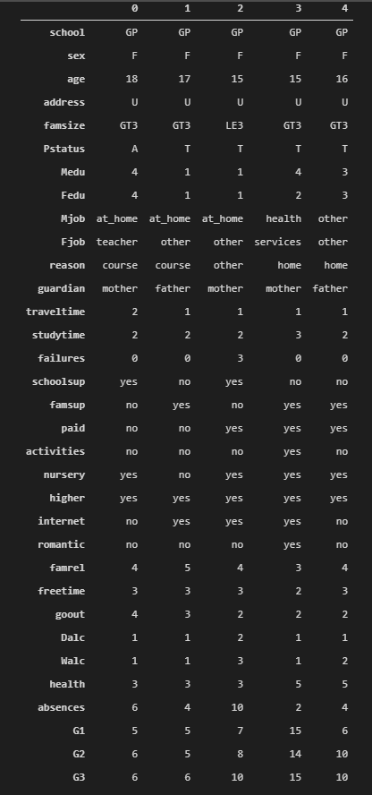
FEatures
Notes:
I cant see anything here, maybe drop the head part? As this won’t be visibal
Mention no NAs

Slide 5
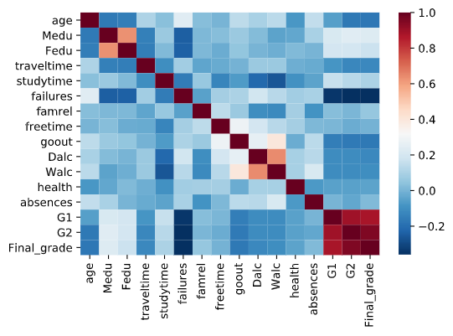
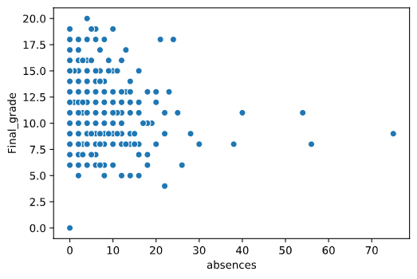
plots
Correlation matrix based on Spearman
Notes:
TODO: maybe put one plot on one slide? Now these are very small and labels not visible at all
There are lots of columns so lets create a subset of data based on heatmap.

Slide 6
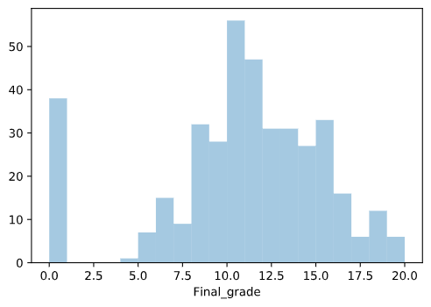
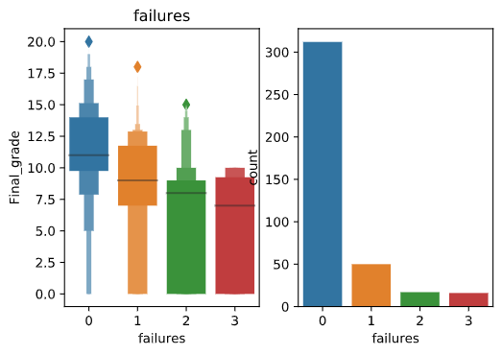
plots
Notes:
When showing the histogram with final grade, please mention that there are lots of 0s and not many below 5 - important for me when talking about hurdle model

Slide 7
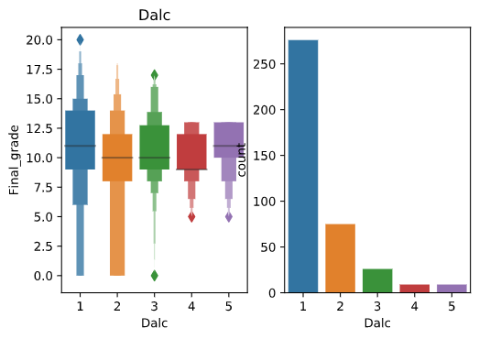
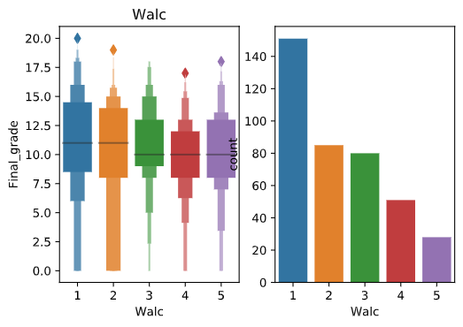
plots

Slide 8
Methods
Linear model
SVM
KNN
Ridge and Lasso
Wıll talk here about why we use ridge how we tried to avoid overfit bla blabla
Notes:
Add hurdle

Slide 9
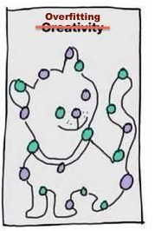
Linear Model
With one variable at the time
With all features from Mutual ınfo
R2 train: 0.24458652935703795 R2 test: 0.0660277149203996
RMSE train: 16.59793696985791 RMSE test: 15.636440983628768
MAE train: 3.177234569559947 MAE test: 3.056795196376448
R2 train: 0.24458652935703795 R2 test: 0.0660277149203996
Notes:
Round the scores, remove MAE (or even RMSE? dunno)
That slide is very off actually

Slide 10
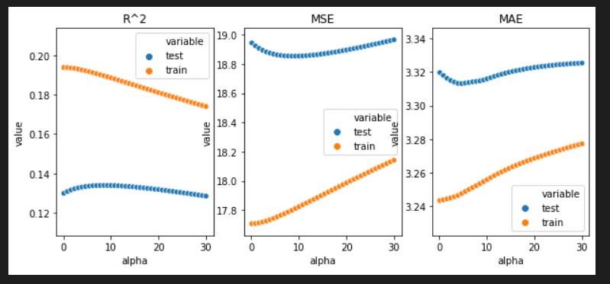
Fıghting with overfitting -Ridge
R2 train: 0.18488831363742242
R2 test: 0.19556222030084514
RMSE train: 17.909625548675272
RMSE test: 13.467791355495258
MAE train: 3.259580203075185
MAE test: 2.710594372447218
Notes:
Plot larger, one score (R2?), round the scores
Scores with best alpha at 10

Slide 11
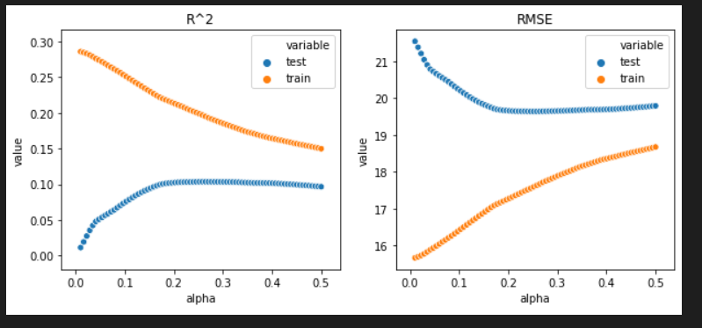
Fıghting with overfitting -Lasso
R2 train: 0.18259747623034983
R2 test: 0.10054442356484294
RMSE train: 17.959959804507935
RMSE test: 15.058566793687524
MAE train: 3.27516333080704
MAE test: 2.8607161991464856
Notes:
Same as ridge
Scores with best alpha at 10

Slide 12
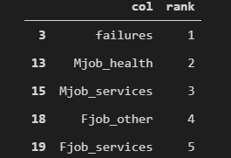
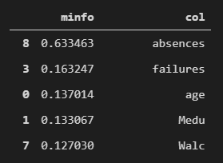
Feature Selectıon
RFE
Mutual Info
Notes:
TODO: Copy the table contents, not the photo – to keep the same font

Slide 13
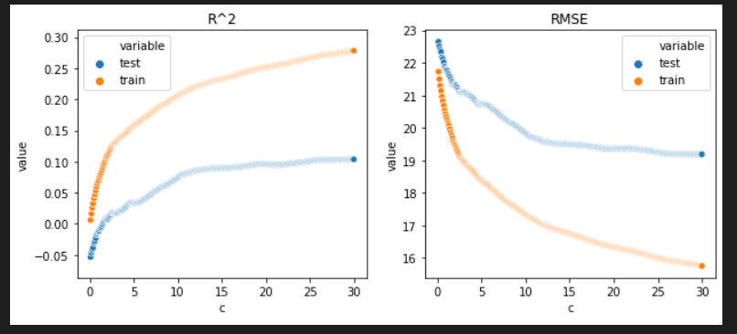
SVM

Slide 14
Model Comparison

Slide 15
Conclusions
Our Fails
KNN
SVM with features from linear model
Linear model with mutual information features
General take-aways
R^2 around 20% is very poor
SVM was the best model, with Ridge being almost as good

